Slide 1
Open Data as a Resource for Legal Tech Projects and Startups
Clemens Wass
openlaws GmbH
BO-ECLI Conference, June 9, Athens

Slide 2
BETTER ACCESS TO JUSTICE
Aggregation >> Personalization >> Collaboration

Slide 3
openlaws
openlaws is an innovative legal data aggregation and collaboration platform.
We help businesses to achieve legal and regulatory compliance through mass-customization and personalization of legal content.
Our platform is used as compliance management system and has been already successfully used for ISO certification.

Slide 4
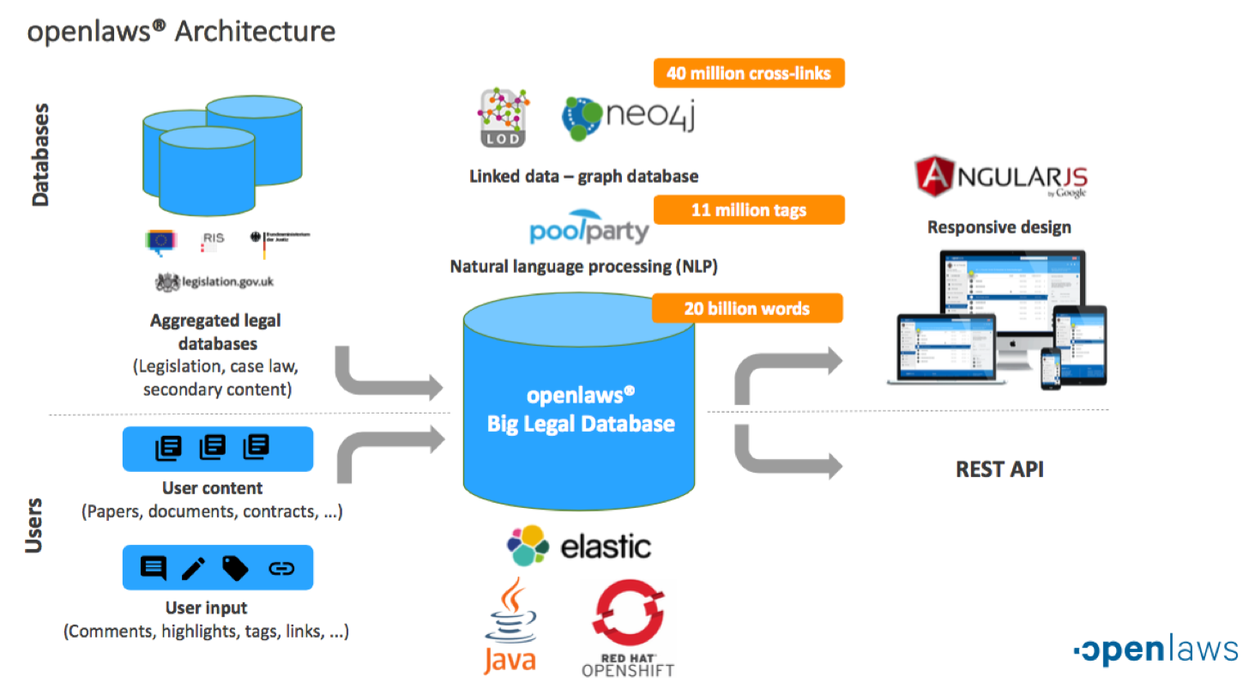

Slide 5
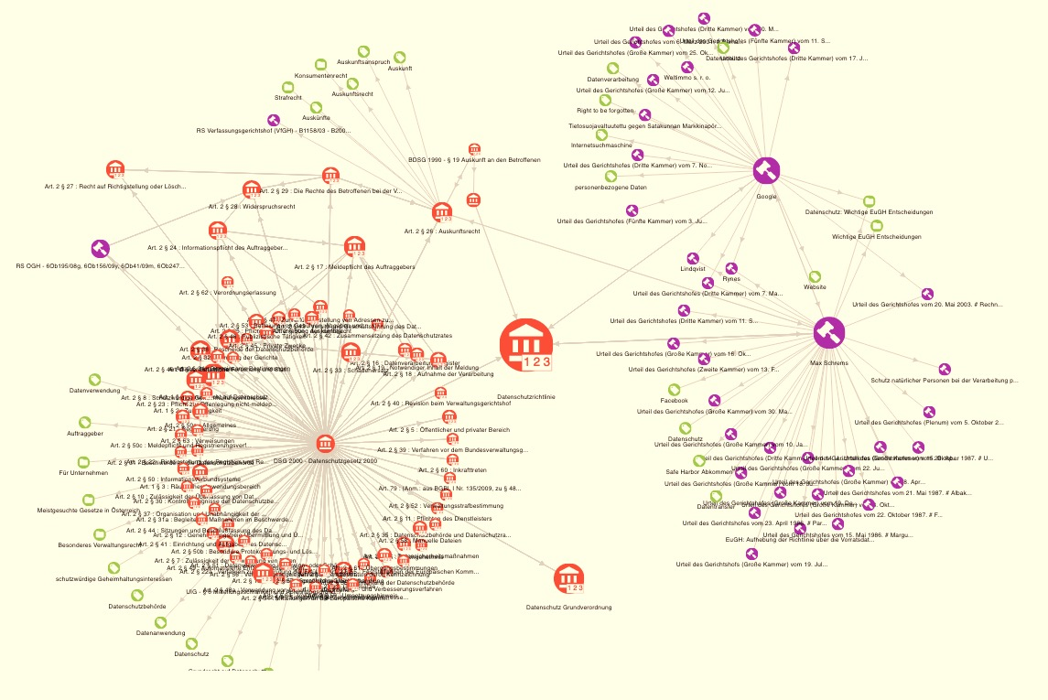
VISUAL
EXPLORATION
Linked Legal Data

Slide 6
AC&Friends joined
Marketing activities
openlaws® prototype
Early stage investor
(8/2015)
Preparing market entry
(6/2016)
Customer: SONY
PWC partnership
EU project start (550k €)
(4/2014 – 3/2016
First paying customer
(2/2016)
Reseller
(2/2017)
AWS funding
ODINE funding
Public funding (100k €)
(12/2014 – 12/2015)
For contracts (100k €)
(1/2016 – 6/2016)
Beta version
Linked Data Award
openlaws.com live
(2/2016)
European Award 2016
(11/2016)

Slide 7
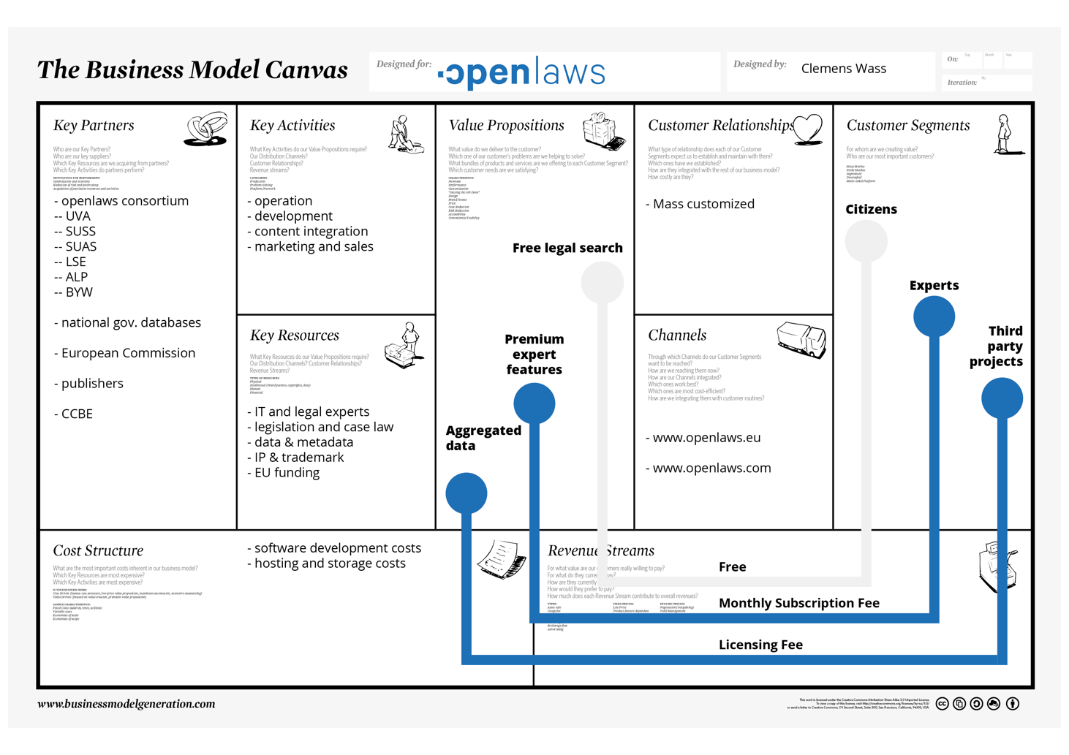
A KEY
RESOURCE
...
AND IT‘S
FREE

Slide 8
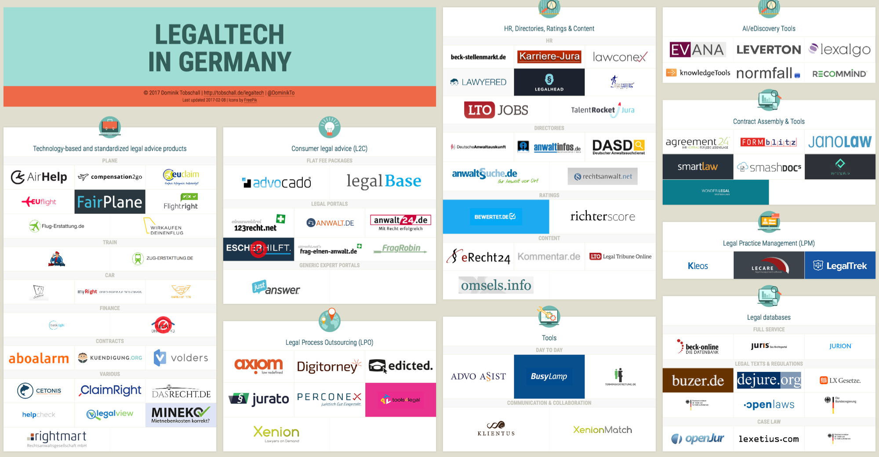

Slide 9
Casetext
Efficient, intelligent, and accessible legal research.
We're empowering litigators to better serve their clients through advanced information services, backed by cutting edge technology, and expert analysis from the legal community

Slide 10
Ravel
Ravel is analytical research, a new category of intelligent tool that combines legal research and analytics. Powered by expert legal knowledge, machine learning, and comprehensive caselaw from the Harvard Law Library, Ravel is built by digital natives for 21st Century practice.

Slide 11
compass
We're about to combine 47 years of history as a case law publisher with the latest technologies to guide your research in new and exciting ways. Change is coming. Come with us.

Slide 12
EuroCases
EuroCases is the most comprehensive collection of national and European case law linked to International and EU law. It aggregates about 40 official legal information sources and around 300,000 documents in a single searchable database

Slide 13
Lexbase
Lexbase contains judgments of the Swedish courts in criminal and civil courts. The documents contain all the information registered by the authorities about the person or company and are presented in a clear and accessible way. A similar database is kept for doctors and dentists.

Slide 14
Weblaw
The Swiss company combines technology, publishing, consulting and training in one organisation.

Slide 15
APIAX
Transforming regulations in a truly digital way
With our in-depth understanding of the needs of the financial service industry and by combining comprehensive legal & compliance expertise with state-of-the-art technology, we help our clients, be it a bank, asset manager or FinTech Startup, to transform complex regulations into digital compliance rules and to manage regulations in a truly digital way.
Notes:
Which open data sets do you use? -> Laws / regulations and court decisions from various countries
What is your business case? -> We transform complex regulations in to easy to use digital compliance rules. Through an API we offer our clients binary answers to regulatory questions relevant for conducting financial activities in various countries. Sourcing these digital rules involves standardization of legal text and mapping attributes originating from regulations with attributes describing the business context of a specific financial activity.
Who is your customer? -> Financial institutions such as Banks, Asset Managers etc.
What is good/bad when working with open legal data? -> Good: it is free -> Bad: Structure of laws / regulations and taxonomies used vary from country to country; data format is typically pdf or text, while accessing legal data through an API would be much more efficient
What are your needs? -> Short-term: make laws accessible through an API instead of pdf files; mid-term: define global standards / taxonomies how to structure laws (name, description, dependencies etc.)

Slide 16
PublicAccess.eu
PublicAccess.eu is a pilot project launched in 2014 by the European Parliament to facilitate online access to a wider range of unclassified documents held by EU institutions, and to increase the transparency of decision-making in the EU. The main objectives of the pilot project are to identify and bring together the relevant unclassified documents which can be made available to the public in a user-friendly way.

Slide 17
Geneva Centre for the Democratic Control of Armed Forces (DCAF)
DCAF’s rationale was, that as long as citizens do not have access to the legislation governing their security sector, they are not in a position to claim their rights. Fostering the ‘rule of law’ (which also formed and continues to form part of all the EU Neighbourhood policies/ agreements with Tunisia), requires that citizens first know what the applicable law is.
Notes:
Providing access to Tunisia’s security sector legislation (www.legislation-securite.tn)
By Jonas Loetscher, former Head of Mission (2012 – 2016) at DCAF’s Tunisia office.
Which open data sets do you use?
As of 2006 (when the World Information Summit took place in Tunisia), the authorities started publishing the Official Gazette (in Arabic and French) on the web. Older versions (up to 1990) were published as (badly) scanned PDFs, newer versions as ‘converted’ PDFs (yet copy paste was in most cases not possible, especially for Arabic version). Advanced text recognition software worked rather well for French version, however, not for Arabic version.
What is your business case?
In 2006, the Geneva Centre for the Democratic Control of Armed Forces (DCAF) saw an opportunity to foster transparency on Tunisia’s security sector (see Chart 1 for an illustration of what constitutes the security sector) by documenting and making publicly accessible relevant legislation. At that time, Tunisia was still under authoritarian rule and hardly any information on the organisation of its security sector was available.
Chart 1. Illustration of security sector: The security sector comprises not only the core security providers but also management bodies as well as formal and informal oversight institutions)
Thus, DCAF’s rationale was, that as long as citizens do not have access to the legislation governing their security sector, they are not in a position to claim their rights. Fostering the ‘rule of law’ (which also formed and continues to form part of all the EU Neighbourhood policies/ agreements with Tunisia), requires that citizens first know what the applicable law is.
A screening of legal texts dealing with the delivery of security in Tunisia, including legislation providing for the liberties of civil society and media to hold the authorities accountable, revealed that there are more than 2’000 texts (from Constitution to laws, to decrees, to decisions). Furthermore, amendments to legislation were not integrated into the source text. As a result, ordinary citizens (as well as government officials after the 2011 revolution) found it almost impossible to know which legislation was applicable at any given moment. DCAF also realised that the effort of digitalizing and integrating amendments was beyond the capabilities (and interest before the revolution) of the authorities.
As a result, DCAF mobilised the necessary funding recruited with local lawyer and legal researchers to undertake the required tasks (prior to the 2011 revolution, all work was carried out under the radar screen of the Tunisian authorities, including a considerable risk for the Tunisian colleagues).
In early 2012, thus after 6 years of work, DCAF released the first comprehensive and structured legal database on Tunisia’s security sector legislation (www.legislation-securite.tn) in both French an Arabic. It became a timely and highly useful source of information in the ongoing process of democratic transition (with the previously oppressive security forces at the centre of attention). It counted roughly 20’000 consultations per month (Staff of the U.S. Embassy in Tunis in 2012 even had translated from French to English the 2’000 titles of the legal texts listed in the database, given that hardly any other information on the structure and functioning of the security services was available!).
Who is your customer?
Customers are:
Government authorities: Many ministries linked their website to the legal database/ used the texts of the legal database for their own websites.
Security forces personnel: Most active users as the legal database allows them to compare their salary and benefit packages with those of other security services
Parliament, civil society and media: Used database to claim rights and identify gaps in legislation. Example: After 2011, Tunisia did not have any legislation governing its internal intelligence services. This gap was highlighted on the legal database and led to calls by Members of Parliament and civil society representatives for the development of legislation in this field which also reflects democratic standards (thus to prevent past abuses of human rights). As of 2016, the authorities started drafting such legislation.
International actors (EU etc.): The EU’s teams in charge of identifying EU security sector support programmes heavily used the legal database, as evidenced in the public peer review document)
What is good/bad when working with open legal data?
Positive:
Source material (input) is ‘for free’. Thus, it is about creating value of something that already exists.
Rewarding as the legal database actually triggered political and legal changes (drafting of modern intelligence legislation)
Negative:
Difficulty of setting up a sustainable business model (so far, the legal database was donor funded).
Difficult to scale up, as in the Tunisian case, a lot of manual work (digitalization, integration of amendments) is necessary.
Sometimes, published data was not correct/ coherent (between different legal texts or between Arabic and French version). Difficult to address this, as it was not DCAF’s role to ‘correct’/ ‘edit legislation’
What are your needs?
Finding local partner ready and capable to manage legal database in the long-run (sustainability)
Finding ways to link with similar legal databases in other countries (comparing legislation). This is difficult as security sectors are structured differently in every country.
DCAF is an international organization committed to support countries in improving security sector governance (security is delivered by state to citizens in line with their needs in an efficient, effective, transparent and accountable way). For more information, please visit: www.dcaf.ch or www.dcaf-tunisie.org.

Slide 18
A KEY
RESOURCE
...
AND IT‘S
FREE

Slide 19
Thank you
openlaws gmbh
Dr. Clemens Wass, MBL, MBA
clemens.wass@openlaws.com
https://openlaws.com/

